Slide 1
Artificial intelligence
Session – 4
Date – 21st May, 2022

Slide 2
Python pandas Series
Pandas is a library that is used for Data Manipulation and Analysis.
A series in Python is a kind of one-dimensional array of any data type that we specified in the pandas module. The only difference you can find was, that each value in a Python pandas series is associated with the index. The default index value of it is from 0 to number – 1, or you can specify your own index values.
The following long list of examples helps you understand this Python pandas Series, how to access them, alter the items, indexes, columns so on.

Slide 3
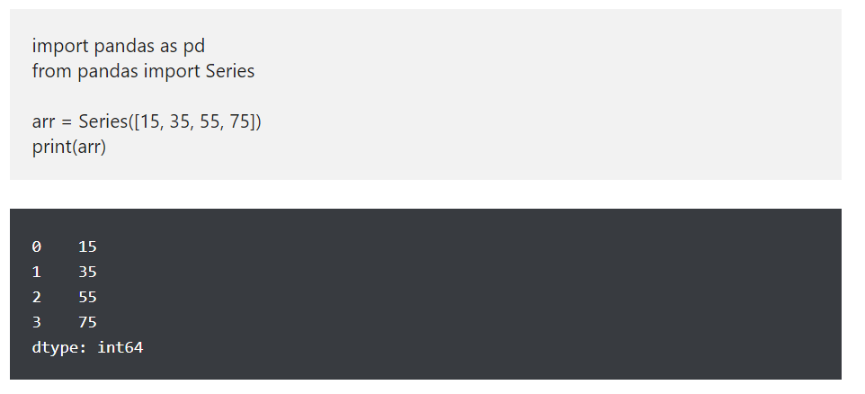
Python pandas Series Examples

Slide 4
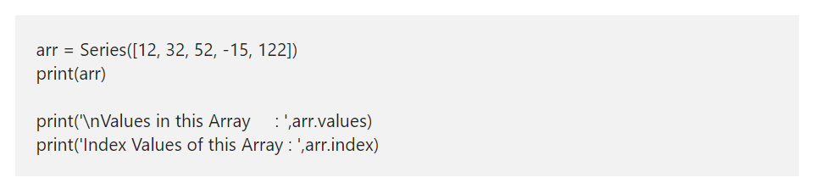
Python Series Values and Index
The Python Series has two attributes, such as values and index. You can use these attributes to get information about them.
values: This returns the array of actual data or elements in it.
index: As the name suggests, this object returns the index values.

Slide 5
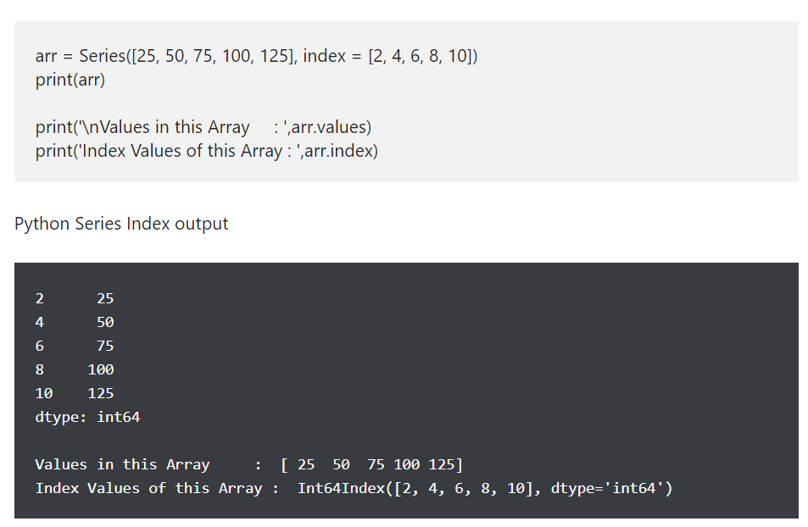
Python pandas Series Index

Slide 6
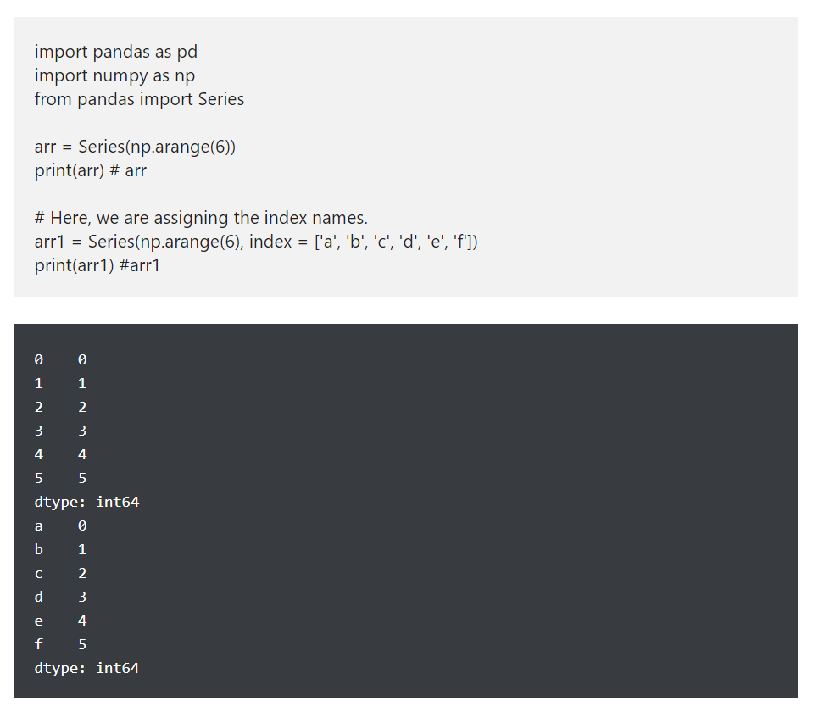
Create a Python Series using arange

Slide 7
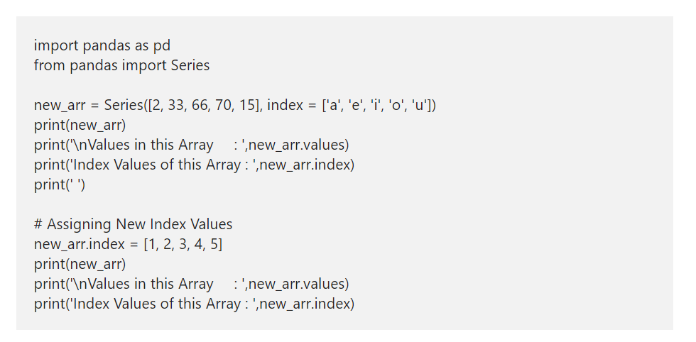
Alter pandas Series Index

Slide 8
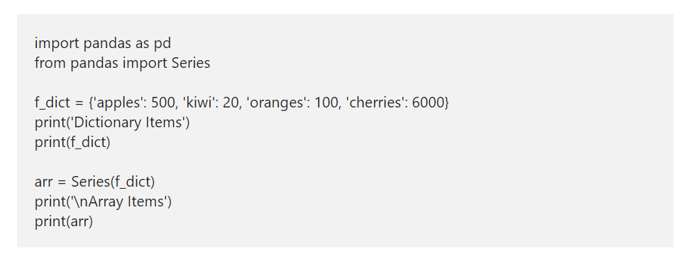
Create a Python Series from Dictionary

Slide 9
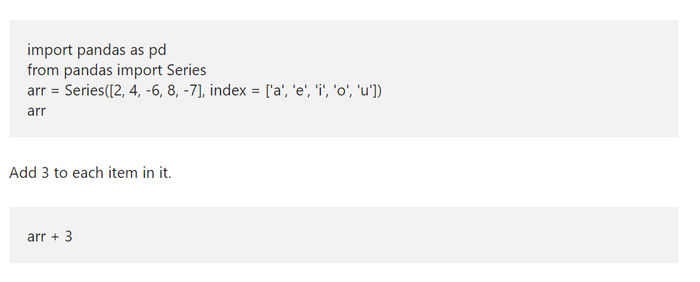
Arithmetic Operations

Slide 10
Python pandas DataFrame
Pandas DataFrame in Python is a two dimensional data structure. It means, python pandas dataframe stores data in a tabular format i.e., rows and columns. In this article, we show how to create Python Pandas DataFrame, access, alter rows and columns. Next, we will discuss about Transposing DataFrame in Python pandas library, Iterating over rows so on.

Slide 11
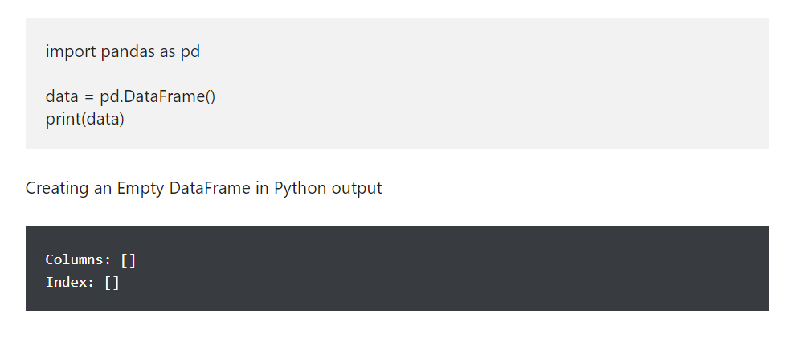
Create an Empty DataFrame in pandas

Slide 12
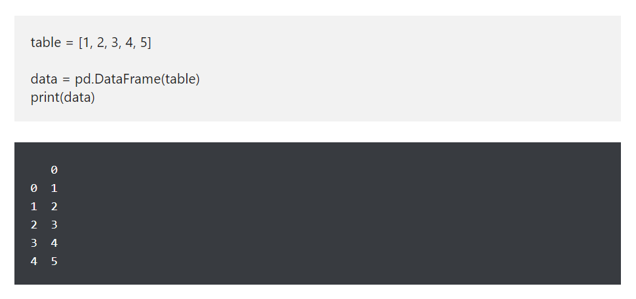
Create pandas DataFrame from List

Slide 13
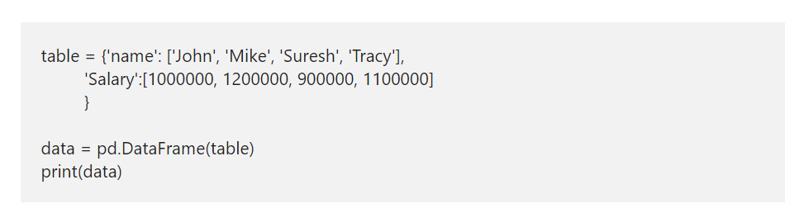
Python Pandas DataFrame from dict
Python pandas allows you to create DataFrame from dict or dictionary. It was pretty much straight forward. All you have to do is, declare a dictionary of different values and then use Python DataFrame function to convert that dictionary to Data Frame

Slide 14
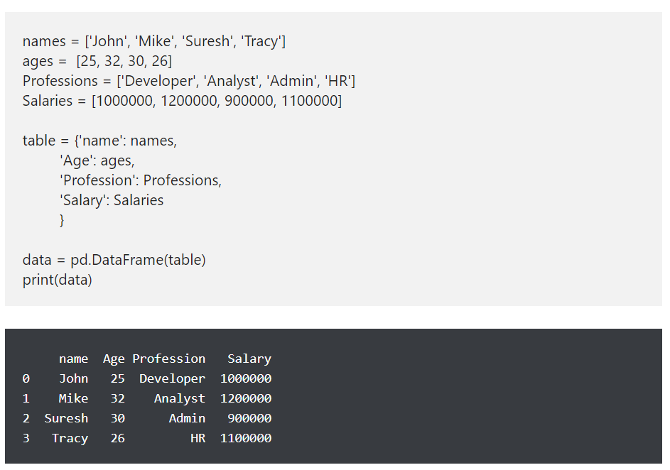
How to create pandas DataFrame from dict of lists

Slide 15
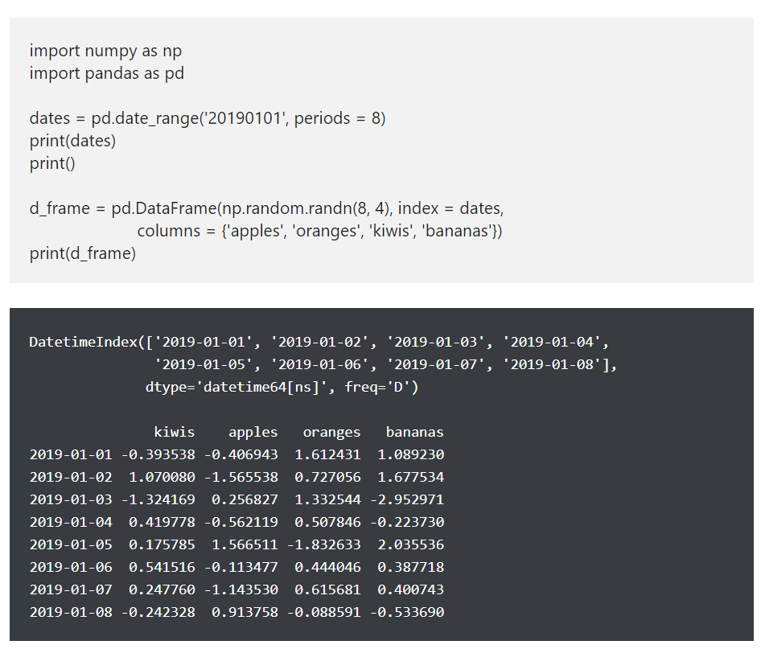
Python Pandas DataFrame of Dates

Slide 16
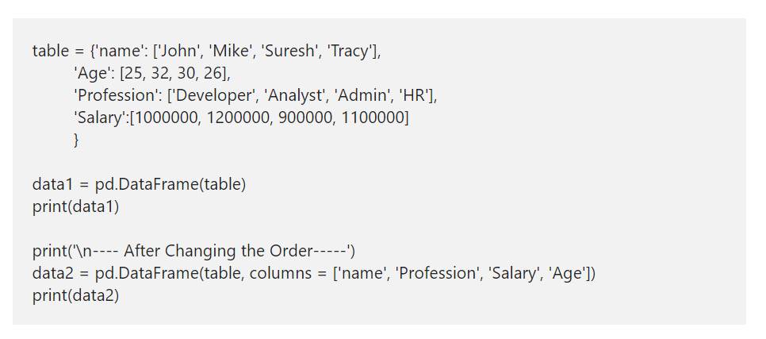
Pandas DataFrame Columns
This example shows how to reorder the columns. By default, Data Frame will use the column order that we used in the actual data. However, you can use the this argument to alter the position of any column. Let me change the Age from 2nd position to 4th.

Slide 17
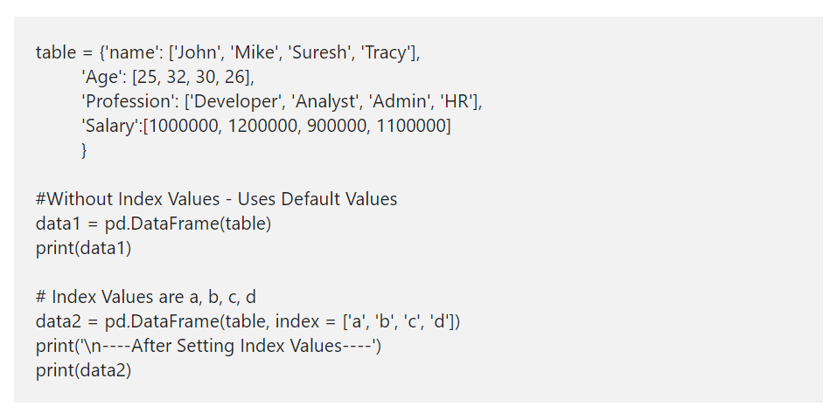
Pandas DataFrame Index
By default, Python will assign the index values from 0 to n-1, where n is the maximum number. However, you have an option to alter those default index values using the index attribute. Here, we using the same and assigning the alphabets from a to d as the index values.

Slide 18
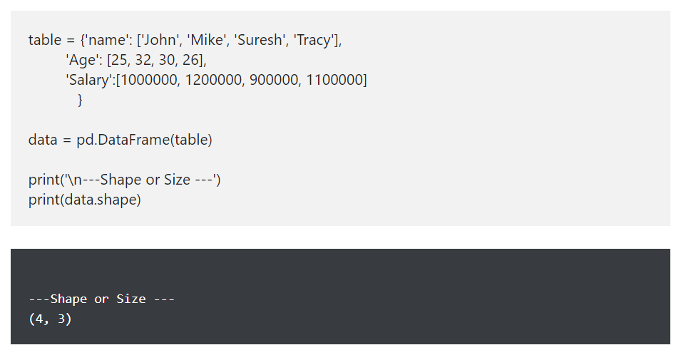
Pandas DataFrame Attributes - shape attribute
The Pandas shape attribute returns the shape or tuple of number of rows and columns in it.

Slide 19
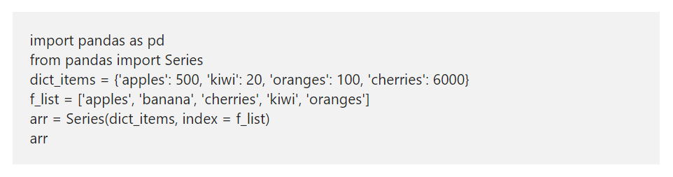
Python Series Nulls
Python pandas module has isnull and notnull functions used to identify the Null and returns a Boolean True or False. To demonstrate the isnull and notnull functions, we are using the same dictionary that we used above.

Slide 20
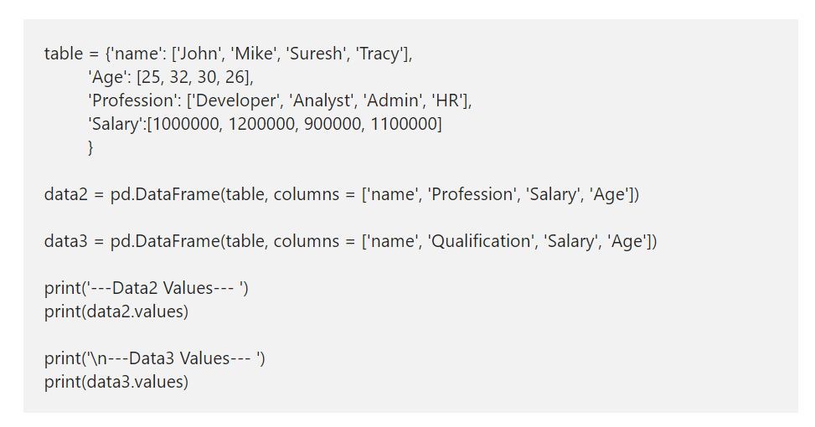
values attribute
The values attributes returns the data (without column names) in a two dimensional array format.

Slide 21
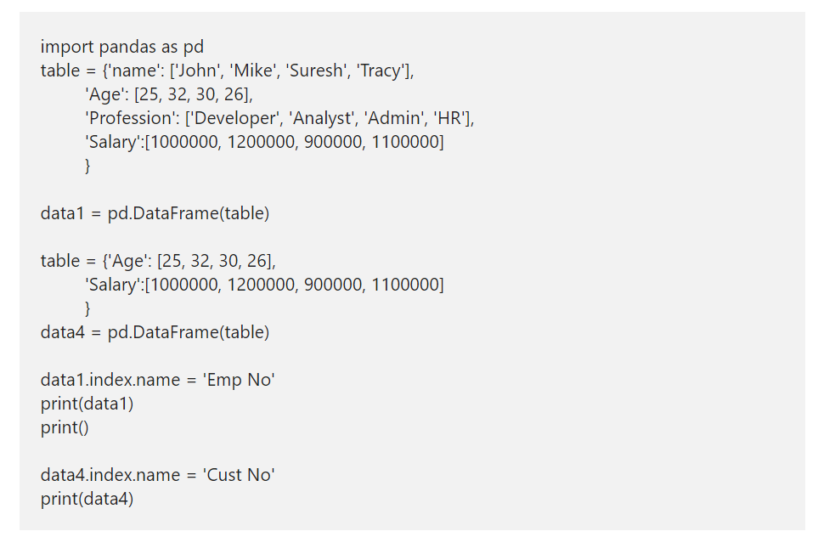
Pandas DataFrame name attribute
The Python DataFrame index and the column has a name attribute, which allows to assign a name to an index or column.

Slide 22
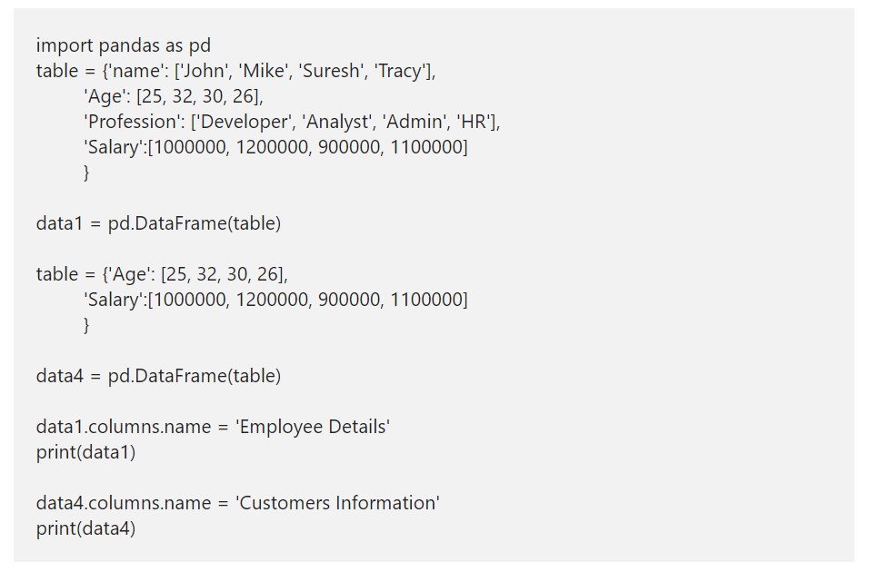
Pandas DataFrame name attribute Contd.
The Python DataFrame index and the column has a name attribute, which allows to assign a name to an index or column.

Slide 23
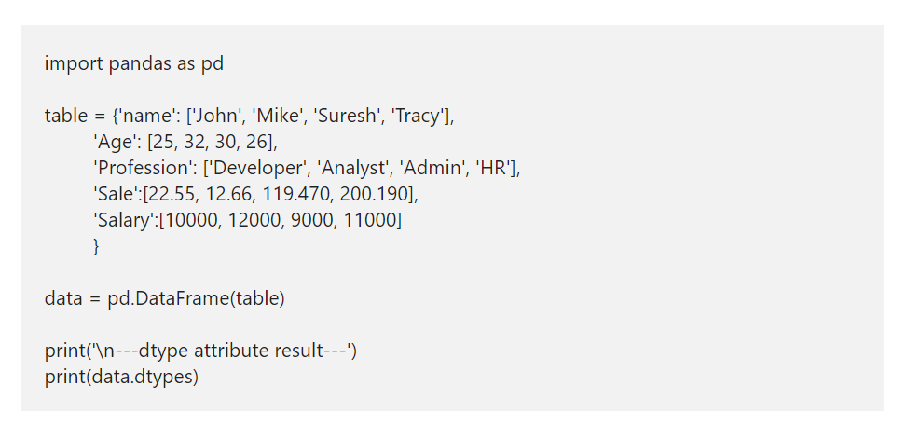
dtype attribute
The dtype attribute returns the data type of each column in the data structures.

Slide 24
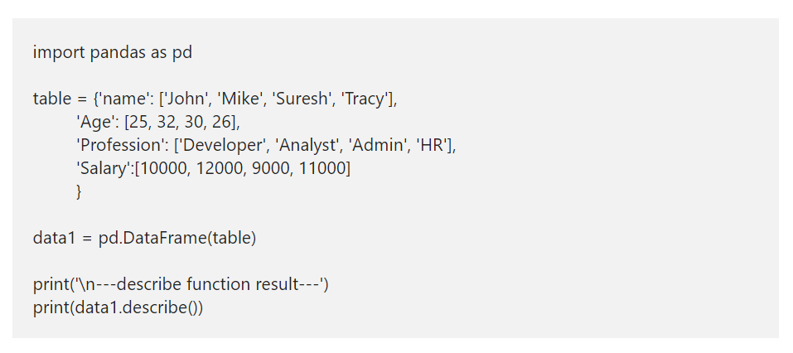
Python DataFrame describe function
Use this python DataFrame describe function to get a quick statistical information about it.

Slide 25
How to access Python DataFrame Data?

Slide 26
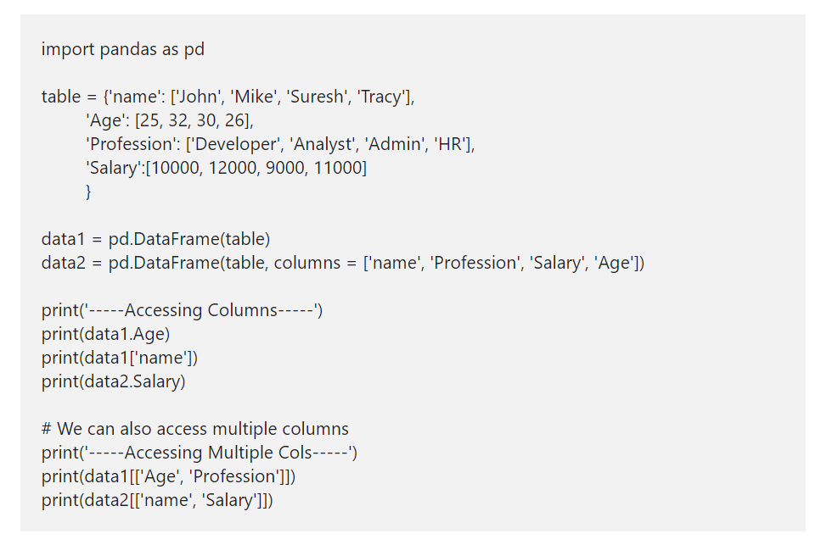
Accessing Pandas Data Frame Columns

Slide 27
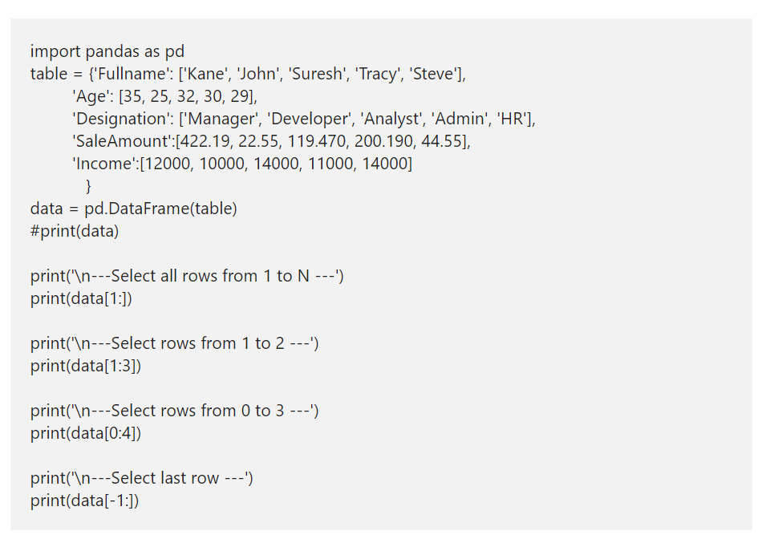
Access Pandas DataFrame Rows
A Pandas DataFrame in Python can also be accessed using rows. Here, we are using the index slicing technique to returns the required rows from it. Here, data[1:] returns all the records in a data structures from index 1 to n-1, and data[1:3] returns rows from index 1 to 3.

Slide 28
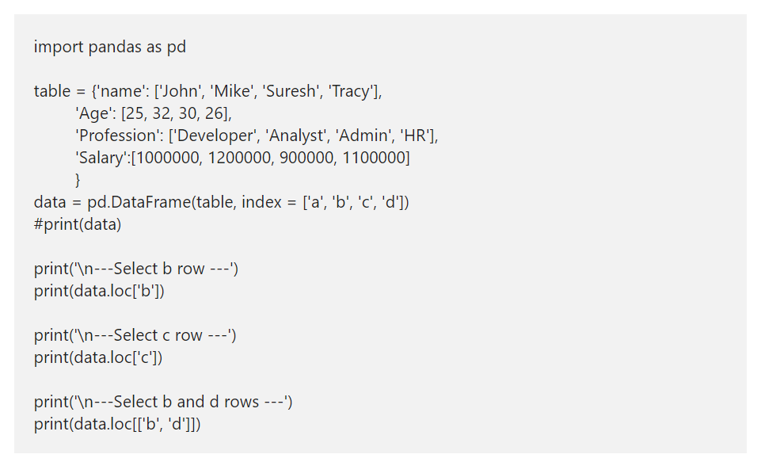
Pandas DataFrame loc method Example
A Pandas loc method is one of the important thing to understand. You can use the loc[] to select more than one column and more than one row at a time. Or, use this Pandas loc[] to select a portion by passing integer location to it. Use this loc method with square brackets to select rows from large datasets.

Slide 29
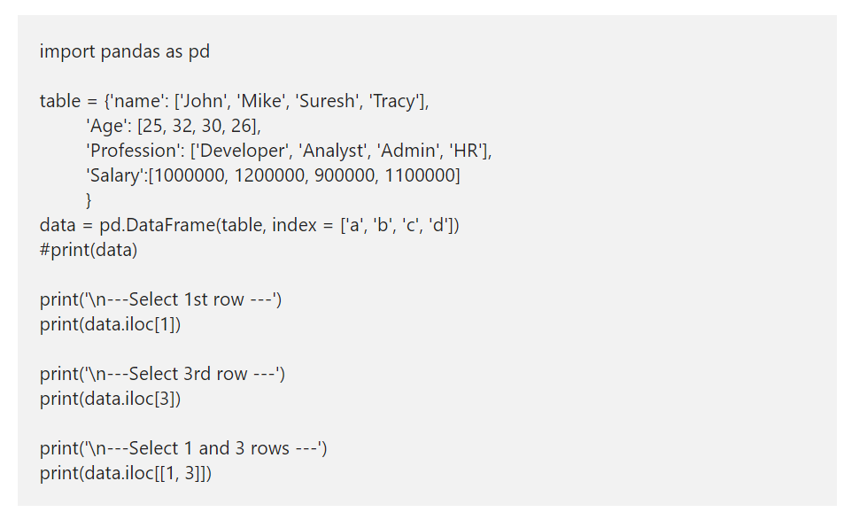
iloc Example
Similar to loc[], Python Pandas DataFrame has iloc[]. However, this will only accept integer values or index to return data.

Slide 30
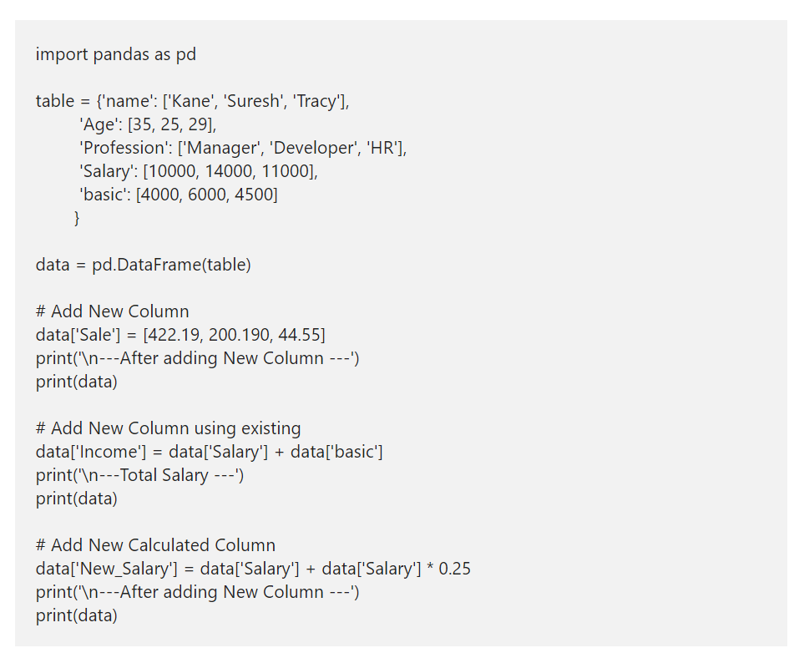
How to add a New Column to Pandas DataFrame?

Slide 31
Delete a Column from a DataFrame in Python
In Python, there are two ways to delete a column from a Pandas DataFrame. Either you can use del function or pop function. In this example, we are going to use both these function to delete columns from it.
Here, del(data[‘basic’]) deletes basic column (complete rows belong to basic column). x = data.pop(‘Age’) deletes or pops Age column, and we are printing that popped column as well. Next, we used the drop function to delete Sale column.

Slide 32
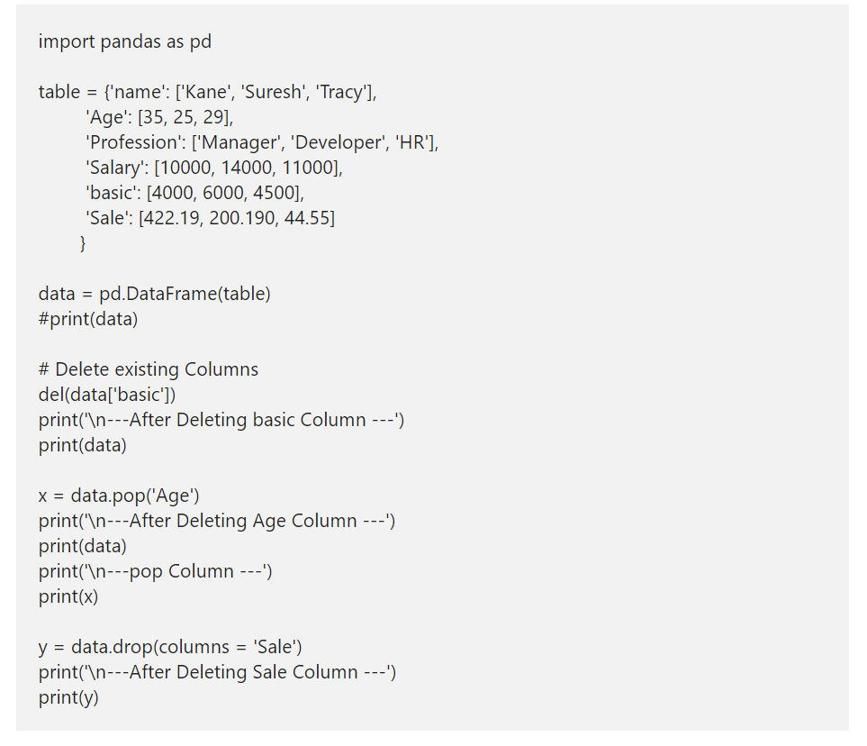
Delete a Column from a DataFrame in Python

Slide 33
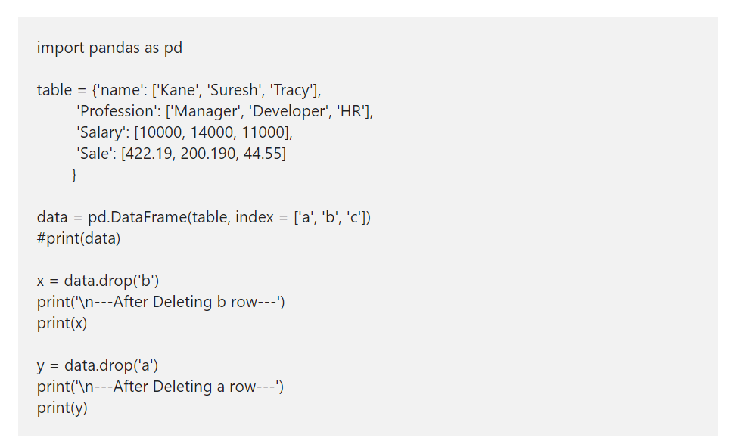
How to delete DataFrame Row in Python?

Slide 34
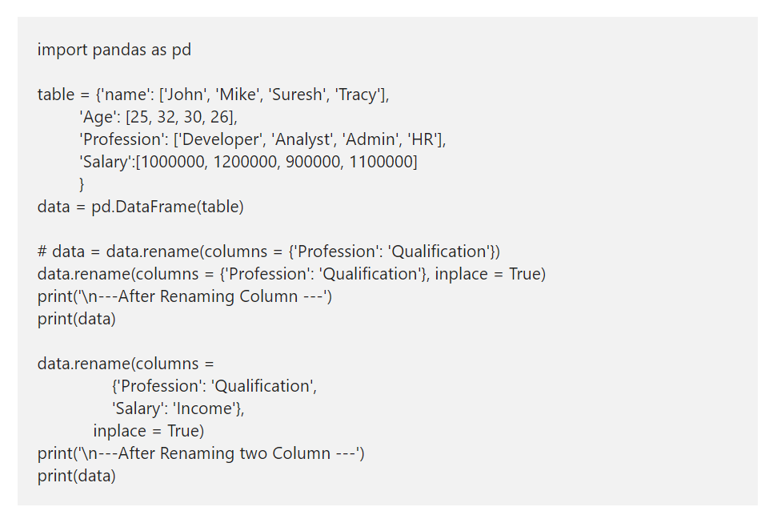
How to rename Pandas DataFrame Column?

Slide 35
Python pandas head and tail
If you are coming from R programming, you might be familiar with head and tail functions. The head function accepts integer value as an argument and returns Top or first given number of records.
For instance, head(5) returns Top 5 records. Similarly, Python DataFrame tail function returns bottom or last records. For example, tail(5) returns last 5 records or bottom 5 records.

Slide 36
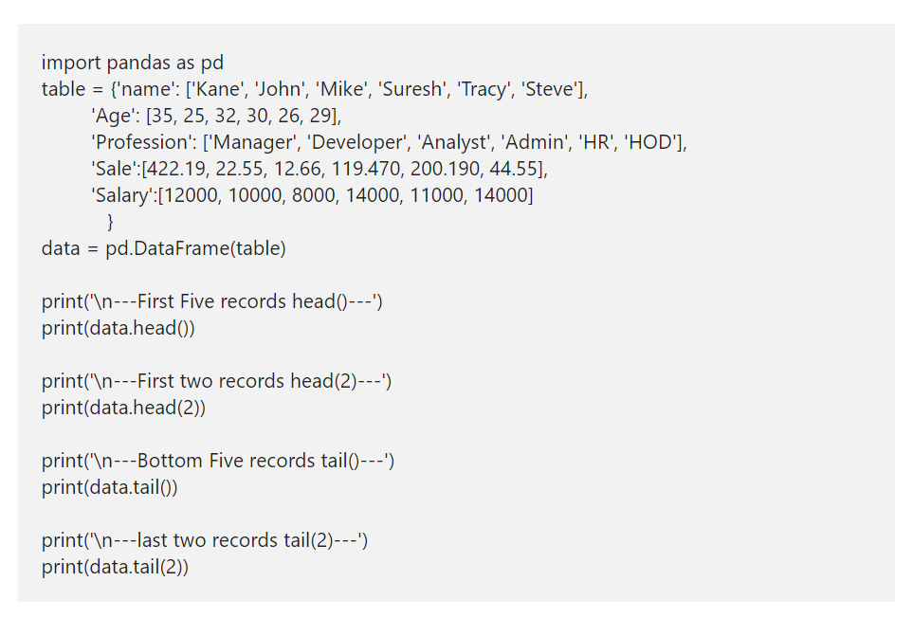
Python pandas head and tail

Slide 37
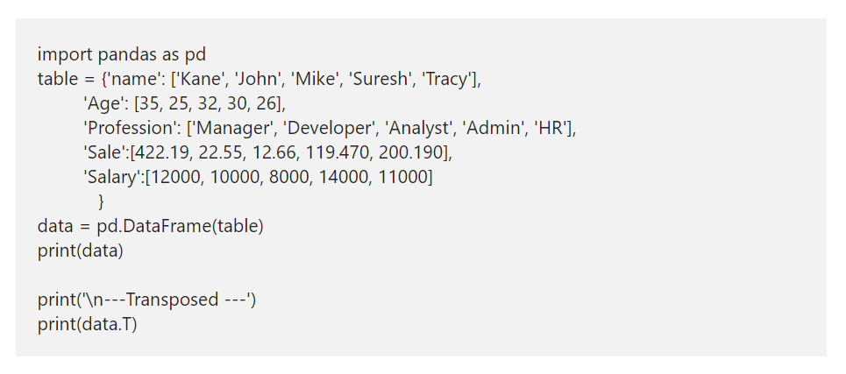
Transpose pandas DataFrame in Python
Transpose pandas DataFrame in Python

Slide 38
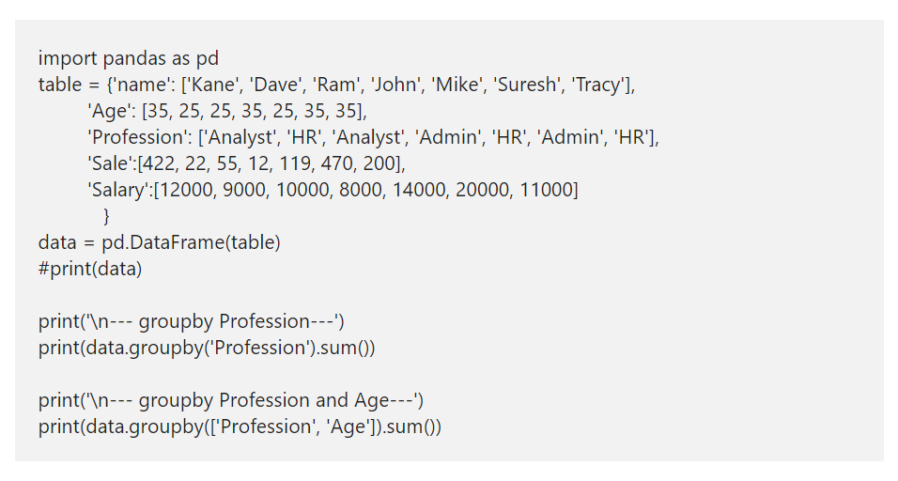
Python DataFrame groupby
A Python DataFrame groupby function is similar to Group By clause in Sql Server. I mean, you can use this Pandas groupby function to group data by some columns and find the aggregated results of the other columns. This is one of the important concept or function, while working with real-time data.

Slide 39
CHARTS

Slide 40
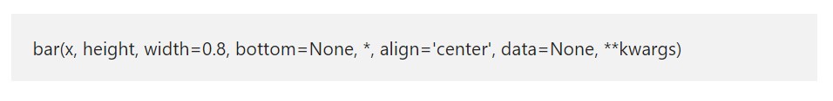
Python matplotlib Bar Chart
A Python Bar chart, Plot, or Graph in the matplotlib library is a chart that represents the categorical data in a rectangular format. By seeing those bars, one can understand which product is performing good or bad. It means the longer the bar, the better the product is performing. In Python, you can create both horizontal and vertical bar charts using this matplotlib library and pyplot.
The Python matplotlib pyplot has a bar function, which helps us to create this chart or plot from the given X values, height, and width. The basic syntax of the Python matplotlib bar chart is as shown below.

Slide 41
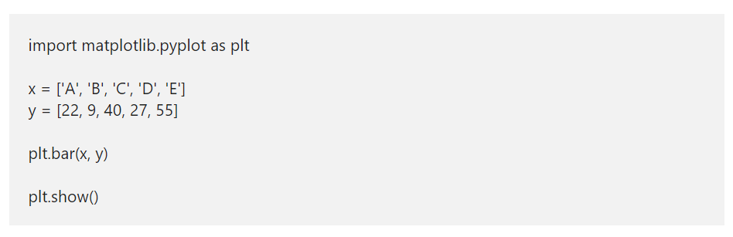
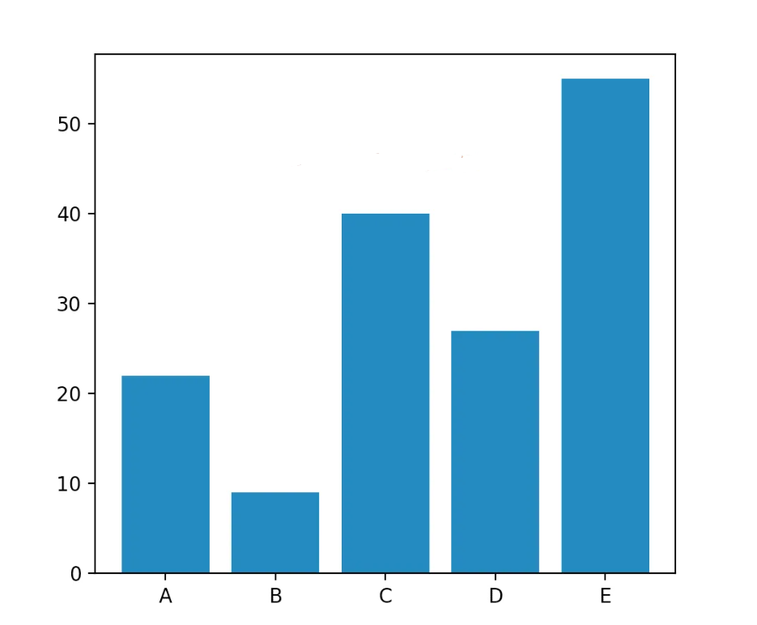
Create a Basic matplotlib bar chart in Python

Slide 42
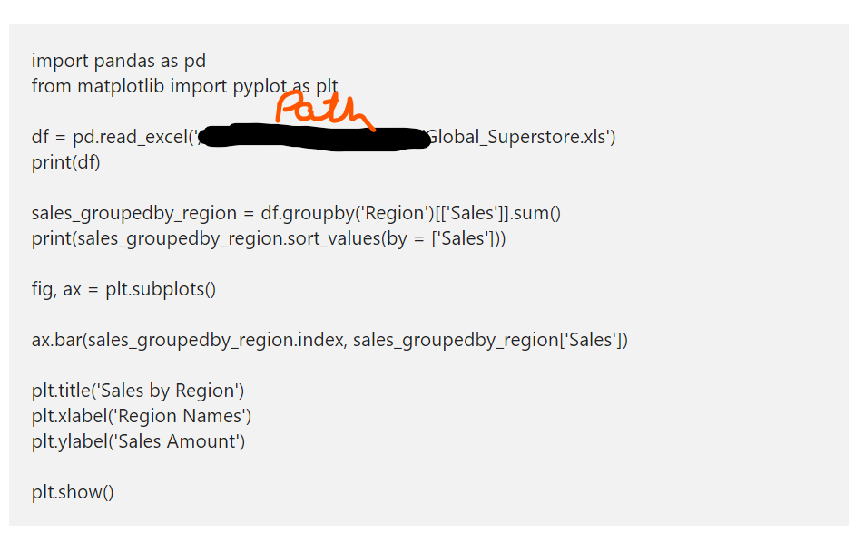
Python matplotlib Bar chart from CSV file

Slide 43
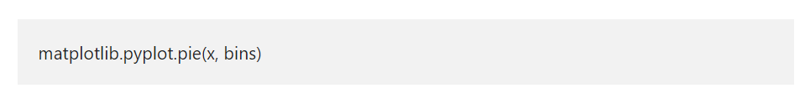
Python matplotlib Histogram
The Python matplotlib histogram looks similar to the pyplot bar chart. However, the data will equally distribute into bins. Each bin represents data intervals, and the matplotlib histogram shows the comparison of the frequency of numeric data against the bins.
In Python, you can use the Matplotlib library to plot histogram with the help of pyplot hist function. The hist syntax to draw matplotlib pyplot histogram in Python is

Slide 44
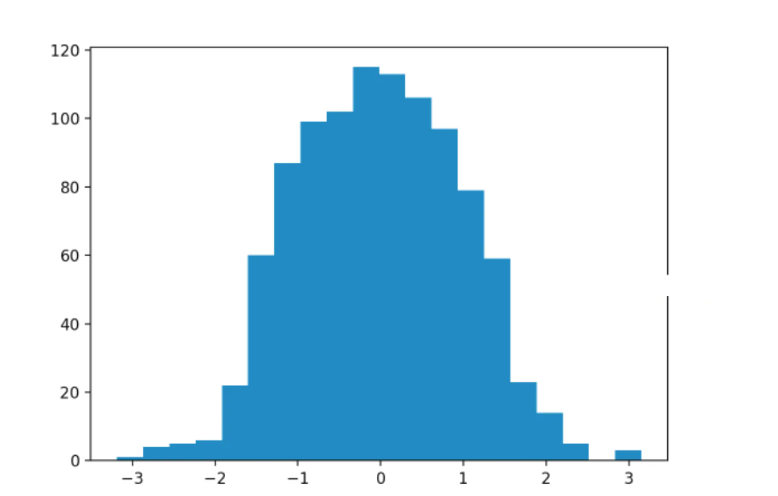
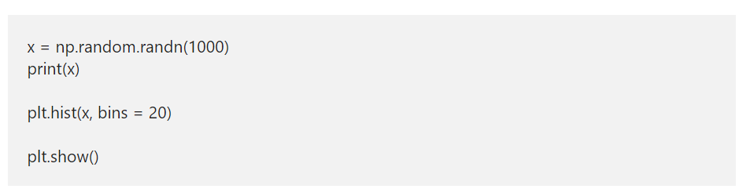
Simple matplotlib Histogram Example
Here, we used this argument number explicitly by assigning 20 to it. It means, below code will draw a hist of random numbers, and the data will equally distribute into 20 bins.

Slide 45
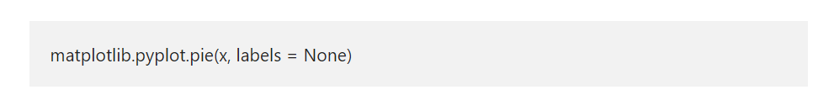
Python matplotlib Pie Chart
The Python matplotlib pie chart displays the series of data in slices or wedges, and each slice is the size of an item. In order to draw at the matplotlib chart in Python, you have to use the pyplot pie function. The syntax of this Python matplotlib pie function is

Slide 46
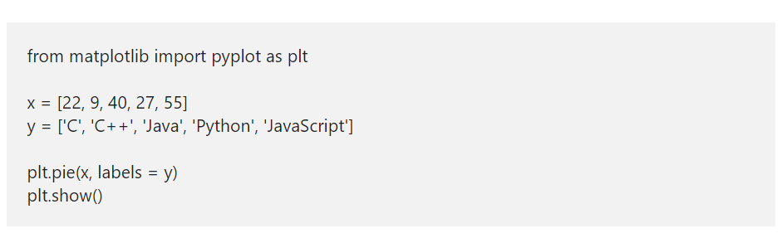
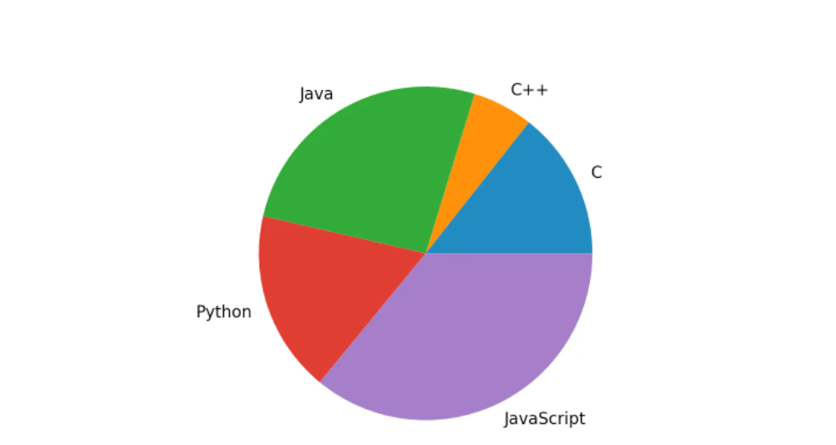
Python matplotlib Pie Chart Example

Slide 47
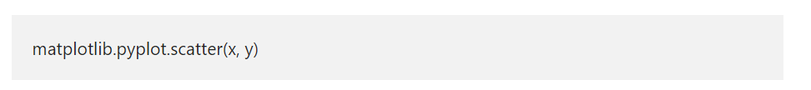
Python matplotlib Scatter Plot
The Python matplotlib scatter plot is a two dimensional graphical representation of the data. A Python scatter plot is useful to display the correlation between two numerical data values or two sets of data. In general, we use this Python matplotlib scatter plot to analyze the relationship between two numerical data points by drawing a regression line.
The matplotlib pyplot module has a function, which will draw or generate a scatter plot in Python. The basic syntax to draw matplotlib pyplot scatter plot is
x: list of arguments that represents the X-axis.
y: List of arguments represents Y-Axis.

Slide 48
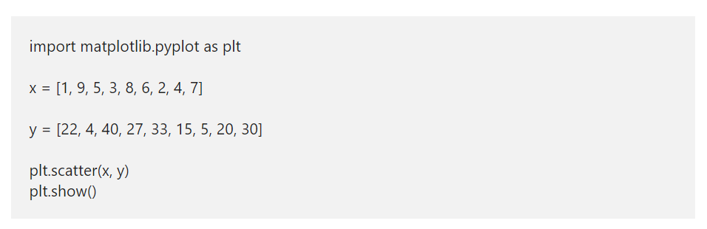
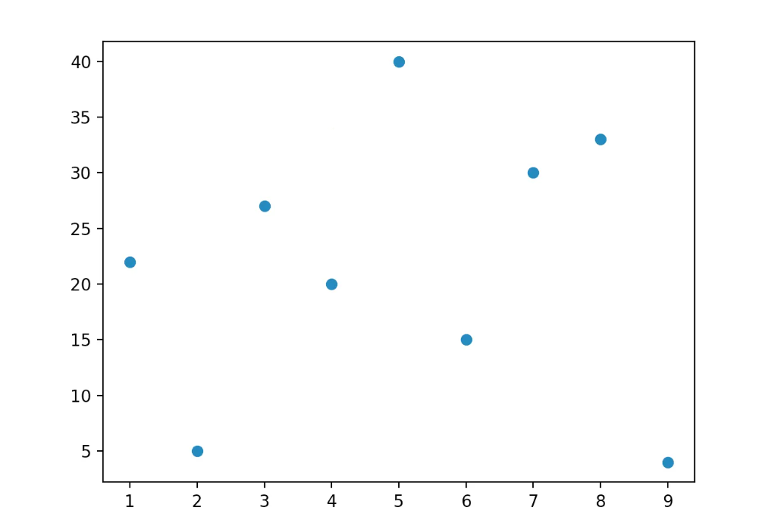
Python matplotlib Scatter Plot Examples

